Slide 1

Security Management for
Cloud Computing
Notes:
<number>

Slide 2
Intro to AWS
AWS Region
US-WEST (N. California)
EU-WEST (Ireland)
EU-Central (Frankfurt)
GOV CLOUD
China (Beijing)
ASIA PAC (Tokyo)
US-EAST (Virginia)
US-WEST (Oregon)
ASIA PAC (Singapore)
SOUTH AMERICA (Sao Paulo)
ASIA PAC (Sydney)
Notes:
Regions consist of 1 or more AZs
AZs are equivalent to Clusters of DCs
<number>

Slide 3
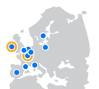
A European view of Cloud
Regions:
Dublin (EU-West) – 3 x Availability Zones
Launched in 2007
Frankfurt (EU-Central) – 2 x Availability Zones
Edge Locations:
Amsterdam, The Netherlands (2), Dublin, Ireland, Frankfurt, Germany (3), London, England (3), Madrid, Spain, Marseille, France, Milan, Italy, Paris, France (2), Stockholm, Sweden, and Warsaw, Poland
Direct Connect POPs:
Dublin, London, Frankfurt

Slide 4
























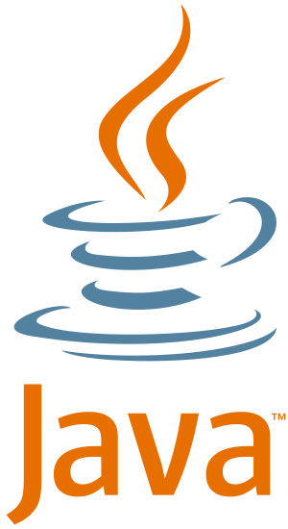


















Overview of AWS Services
Your Applications
Enterprise
Applications
AWS Global Infrastructure
Virtual Desktop
Document Collaboration
Workspaces
Zocalo
Web Interface
Monitoring
Deployment & Automation
Identity & Access
Human Interaction
Deployment &
Management
AWS Global Infrastructure
Management Console
Billing
CloudWatch
BeanStalk
OpsWorks
Cloud Formation
DataPipe
IAM
Federation
Mechanical
Turk
Application
Services
Content Delivery
Applications
Libraries & SDK’s
AWS Global Infrastructure
Distributed Computing
CloudFront
SES
SNS
SQS
Elastic Transcoder
CloudSearch
SWF
EMR
Foundation
Services
Compute
Storage
Networking
Databases
AWS Global Infrastructure
EC2
S3
EBS
Glacier
Storage
Gateway
VPC
Direct Connect
ELB
Route53
RDS
Dynamo
ElastiCache
RedShift
AWS Global Infrastructure
Regions
Availability Zones
Edge Locations
AWS Global Infrastructure
Notes:
<number>

Slide 5
A viewpoint of today
Complexity of systems, network, IT – we’re only getting bigger, more complex, more distributed
Mobile computing – we want data anywhere, on any device
Cloud – instant on, scalable, pay by use
We use technology more to run business, store competitive IP, and undifferentiating tasks are outsourced to specialists

Slide 6
Industry Predictions
By 2017, 70% of successful digital business models will rely on deliberately unstable processes designed to shift as customer needs shift
By 2017, 50% of consumer product investments will be redirected to customer experience innovations

Slide 7
Security Impact
Security directives more important, but more difficult to achieve
Traditional methods of managing security aren’t scaling to the growth of the threat landscape
There is more at stake
Security cannot be a blocker of innovative business

Slide 8
Pace of Innovation: Security vs. All
Notes:
As of May 31, we have launched 275 new services and features in 2015.
<number>

Slide 9
Security & Cloud
Who manages which parts?

Slide 10


AWS Shared Responsibility Model
Customer content
Customers are responsible for their security and compliance IN the Cloud
Platform, Applications, Identity & Access Management
Customers
Operating System, Network & Firewall Configuration
Client-side Data Encryption
Server-side Data Encryption
Network Traffic Protection
AWS Foundation Services
AWS is responsible for the security OF
the Cloud
Compute
Storage
Database
Networking
AWS Global Infrastructure
Availability Zones
Edge Locations
Regions
Notes:
We look after the security OF the cloud, and you look after your security IN the cloud.
<number>

Slide 11
AWS Shared Responsibility Model: for Infrastructure Services
Customer content
Managed by
Platform & Applications Management
Operating System, Network & Firewall Configuration
Customer IAM
Customers
Client-Side Data encryption
& Data Integrity Authentication
Server-Side Encryption
Fire System and/or Data
Network Traffic Protection
Encryption / Integrity / Identity
Optional – Opaque data: 1’s and 0’s (in transit/at rest)
AWS Foundation Services
Managed by
Compute
Storage
Database
Networking
AWS IAM
AWS Global Infrastructure
Availability Zones
Edge Locations
Regions
Notes:
We look after the security OF the cloud, and you look after your security IN the cloud.
<number>

Slide 12
AWS Shared Responsibility Model: for Container Services
Managed by
Customer content
Client-Side Data encryption
& Data Integrity Authentication
Network Traffic Protection
Encryption / Integrity / Identity
Customers
Customer IAM
Optional – Opaque data: 1’s and 0’s (in transit/at rest)
Firewall Configuration
Platform & Applications Management
Managed by
Operating System, Network Configuration
AWS Foundation Services
Storage
AWS IAM
Compute
Database
Networking
AWS Global Infrastructure
Availability Zones
Edge Locations
Regions
Notes:
We look after the security OF the cloud, and you look after your security IN the cloud.
<number>

Slide 13
AWS Shared Responsibility Model: for Abstract Services
Managed by
Customer content
Customers
Optional – Opaque Data: 1’s and 0’s
(in flight / at rest)
Client-Side Data Encryption
& Data Integrity Authentication
Network Traffic Protection by the Platform
Protection of Data at Rest
Network Traffic Protection by the Platform
Protection of Data at in Transit
Managed by
Platform & Applications Management
AWS IAM
Operating System, Network & Firewall Configuration
AWS Foundation Services
Compute
Storage
Database
Networking
AWS Global Infrastructure
Availability Zones
Edge Locations
Regions
Notes:
We look after the security OF the cloud, and you look after your security IN the cloud.
<number>

Slide 14
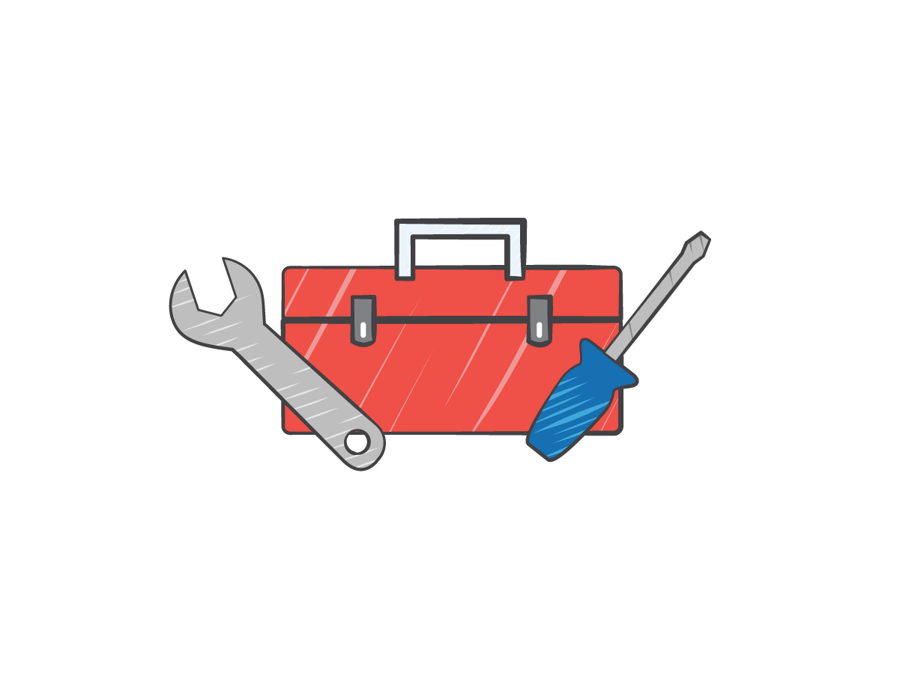
Security Innovations - Summary
Auditing-centric services and features
Identity Access Management (IAM)
AWS Config
AWS CloudTrail
AWS Key Management Service (KMS)
Trusted Advisor checks
VPC Security Features
Policies (for managing resources)
Notes:
<number>

Slide 15


Identity Access Management (IAM)
With AWS IAM you get to control who can do what in your AWS environment and from where
Root in AWS is the same as Root in Windows/Linux
Password Policies
IAM Credentials Reports
Manage Access Keys
Fine grained control of users, groups, roles, and permissions to resources
Integrate with your existing corporate directory using SAML 2.0 and single sign-on
AWS account owner
Network management
Security management
Server management
Storage management
Notes:
Professional Services can help create a Security Run Book
Enterprises segregate important duties to reduce risk of accidental or malicious changes
AWS allows fine-grained segregation across virtually all aspects of the service
For example, you can segregate
Who can change network configuration
Who can change firewalls
Who can change how the VPC connects to the Internet or back to your corporate premises
Who can start and stop servers
Who can snapshot and restore storage volumes
AWS IAM offers a programmatic level of control and granularity that would not be possible to implement in traditional on-premise environments
<number>

Slide 16
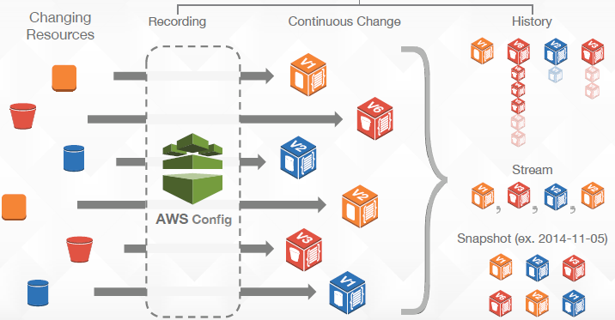
AWS Config
Fully managed service which provides:
An Inventory of your AWS resources
Lets you audit the resource configuration history
Notifies you of resource configuration changes
Notes:
One of important responsibility of security team is to
Segregate roles and responsibilities to a fine-grained level that is probably in excess of what you can do in a physical environment
User A can change firewalls tagged ‘development’ only
User B (system engineer) can snapshot database storage volumes, but cannot access those volumes
Lots of development in this space just now, including the ability to log every action in industry-standard formats
AWS IAM also includes full multi-factor authentication for users, using either hardware Gemalto tokens, or soft tokens running on all three major phone platforms.
One even more awesome feature is that your EC2 instances themselves can have roles within identity and access management, to restrict what AWS APIs the instance can call. Thus, an attacker cannot use an EC2 instance to upload data to S3, if the role assigned to the instance does not include S3 API permissions.
<number>

Slide 17
Use cases enabled by Config
Security Analysis: Am I safe?
Config allows you to continuously monitor and evaluate configuration of workloads
Audit Compliance: Where is the evidence?
Complete inventory of all resources and their configuration attributes @ any point in time
Change Management: What will this change affect?
All resource changes (create,update,delete) streamed to SNS
Troubleshooting: What has changed?
Identify changes in resource to resource relationships
Notes:
<number>

Slide 18
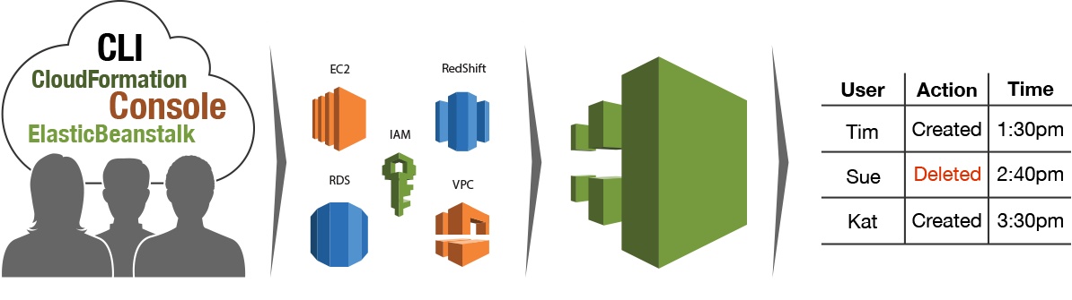
AWS CLOUDTRAIL
AWS CloudFormation
Redshift
AWS Elastic Beanstalk
You are making API calls...
On a growing set of services around the world…
AWS CloudTrail is continuously recording API calls…
And delivering log files to you
Notes:
CloudTrail is your eyes behind the scenes at AWS. It gives you insight into all of the API calls made which are associated with your account(s). It lets you understand the who did what from where, when.
Who made the API call?
When was the API call made?
What was the API call?
What were the resources that were acted up on in the API call?
Where was the API call made from?
All these logs are very useful information for you to analyze the events or detect user behaviors
<number>

Slide 19
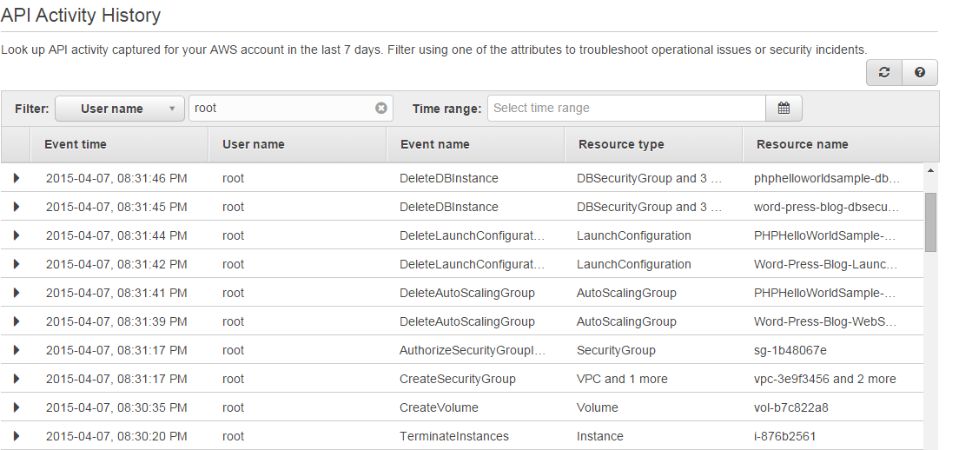
AWS CloudTrail
Notes:
<number>

Slide 20

AWS Key Management Service
A managed service that makes it easy for you to create, control, and use your encryption keys
Integrated with AWS SDKs and AWS services including Amazon EBS, Amazon S3, and Amazon Redshift
Integrated with AWS CloudTrail to provide auditable logs to help your regulatory and compliance activities

Slide 21
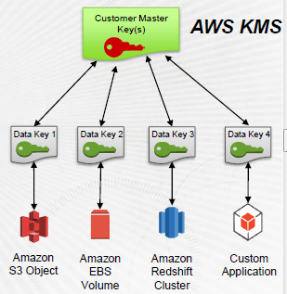
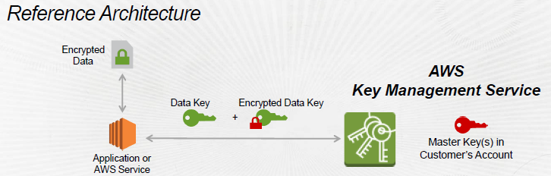
AWS KMS – the detail
2 tier key hierarchy using envelope encryption
Unique data key encrypt customer data
AWS KMS master keys encrypt data keys
Benefits:
Limits risk of a compromised key
Easier to manage a small number of master keys than millions of data keys
Whitepaper: https://d0.awsstatic.com/whitepapers/KMS-Cryptographic-Details.pdf

Slide 22
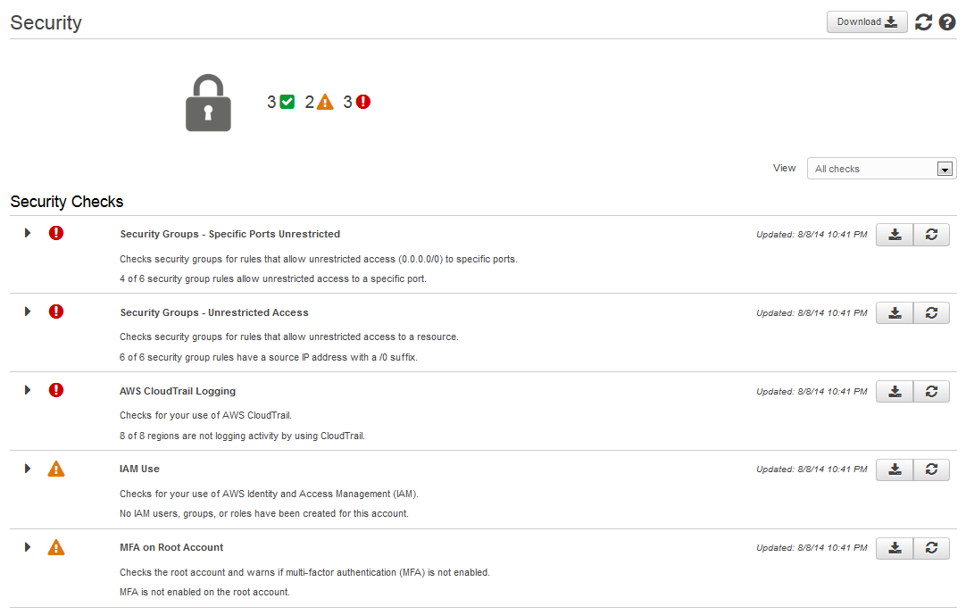
Getting help – Trusted Advisor
Performs a series of security configuration checks of your AWS environment:
----------------
Open ports
Unrestricted access
IAM use
CloudTrail Logging
S3 Bucket Permissions
Multi-factor authentication
Password Policy
DB Access Risk
DNS Records
Load Balancer configuration
Notes:
<number>

Slide 23
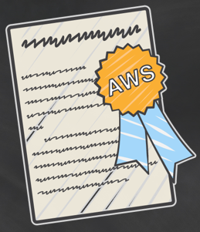
Getting help - AWS Compliance:
Whitepapers & Workbooks
IT Grundschutz (TUV Trust IT)
EU Data Protection
CESG UK Security Principles
Risk & Compliance
Overview of Security Processes
FERPA
FAQs
PCI, HIPAA, EU Data Protection, ISO 27001, 9001 etc…
Quicklabs
Security & Auditing Self Paced Lab available via qwiklab
Blogs
http://blogs.aws.amazon.com/security/
Notes:
<number>

Slide 24
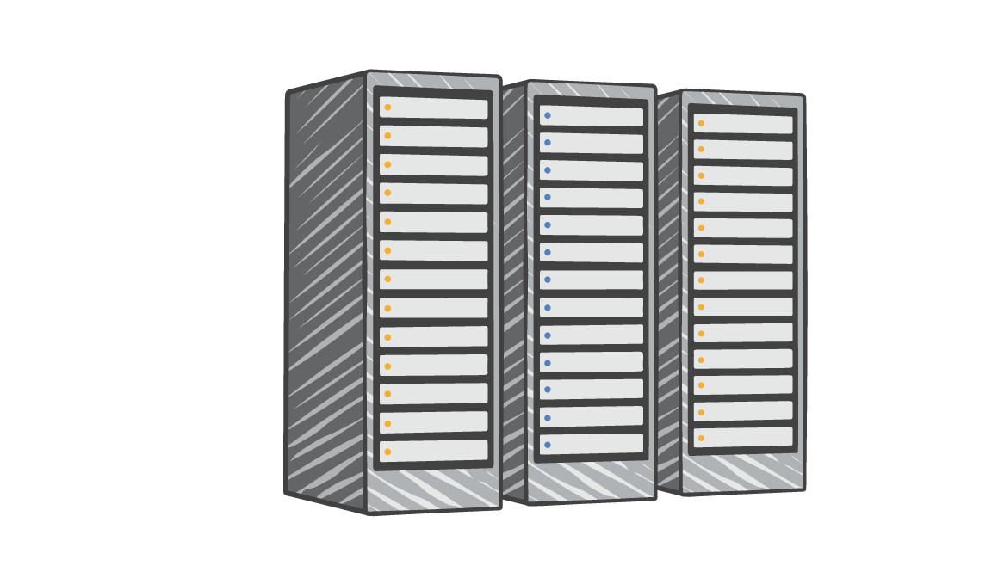
Which Workloads Can You Move?
Examples:
NIST SP 800-53R4
PCI DSS 3.0
Directive 95/46/EC of the European Parliament and of the Council of 24 October 1995
Notes:
DNB as an example of a Financial Regulator we’ve engaged regarding moving workloads to AWS
We are happy to work with regulators in different industries with a view of
<number>

Slide 25
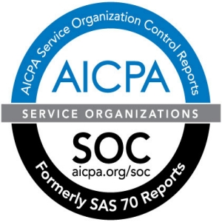
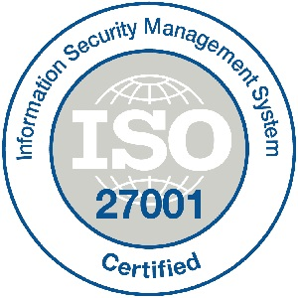
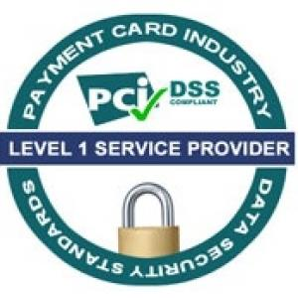

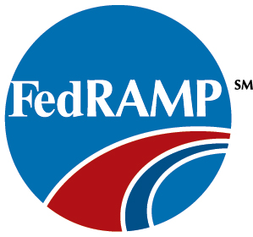






AWS Assurance Programs
Singapore
MTCS
Notes:
<number>

Slide 26
Accreditation & Compliance: on-prem vs on AWS
On-prem
Start with bare concrete
Functionally optional
(you can build a secure system without it)
Audits done by an in-house team
Accountable to yourself
Typically check once a year
Workload-specific compliance checks
Must keep pace and invest in security innovation
On AWS
Start on base of accredited services
Functionally necessary – high watermark of requirements
Audits done by third party experts
Accountable to everyone
Continuous monitoring
Compliance approach based on all workload scenarios
Security innovation drives broad compliance
Notes:
<number>

Slide 27
What this means
You benefit from an environment built for the most security sensitive organizations
AWS manages 1,800+ security controls so you don’t have to
You get to define the right security controls for your workload sensitivity
You always have full ownership and control of your data

Slide 28
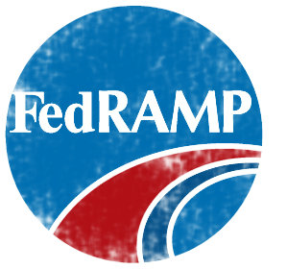


Meet your own security objectives
Your own accreditation
Your own certifications
Your own external audits
Customer scope and effort is reduced
Better results through focused efforts
Built on AWS consistent baseline controls
Customers
AWS Foundation Services
Compute
Storage
Database
Networking
AWS Global Infrastructure
Availability Zones
Edge Locations
Regions
Notes:
<number>

Slide 29









AWS Marketplace (Partner Solutions)
AWS partner solutions
Facilities
Physical security
Compute infrastructure
Storage infrastructure
Network infrastructure
Virtualization layer (EC2)
Hardened service endpoints
Fine-grained IAM capability
+
=
Your secure AWS solutions
These local and global AWS partners provide wide range solutions from intrusion detection, data encryption, user management etc via SaaS and EC2 based Virtual Appliance
Notes:
<number>

Slide 30
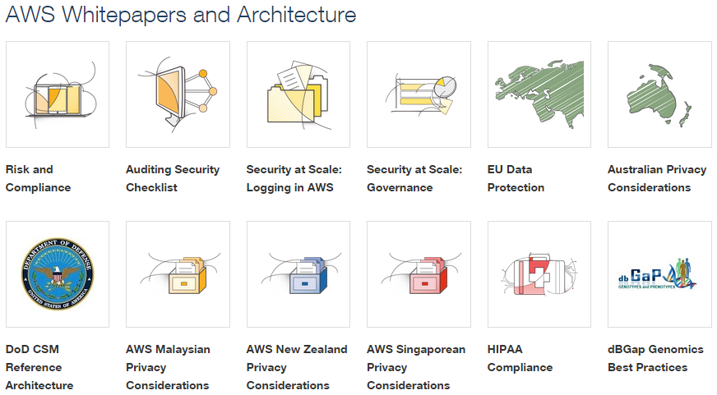
aws.amazon.com/compliance

Slide 31
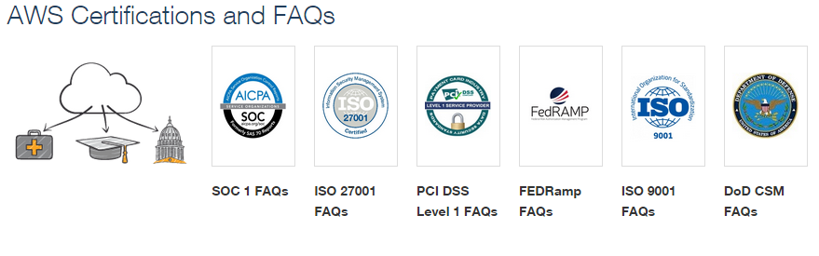
aws.amazon.com/compliance

